Slide 1
Handling Missing Data
Santhosh Kumar BVSRK

Slide 2
Handling Missing Data is one of the data cleaning steps which we perform before doing Visualization or running ML algorithms.
There are many ways in which we can handle missing data as mentioned below:
Mean Method
MICE Method
KNN Method
NOTE: The above mentioned methods are only for Numerical Data.

Slide 3

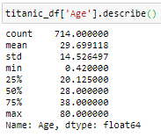
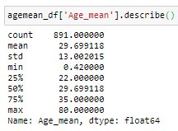
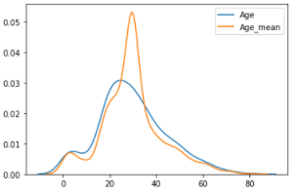
Mean Method
This is the most commonly used method in which we fetch the Mean value of the data frame column and replace that with the missing values.
Let us use Mean Method on Titanic Dataset as shown below on ‘Age’ Column.
There are 177 rows with missing values in Age column.
The stats for Age column before and after Mean method
are as shown in the pic
From the above, we can see that the Standard Deviation,
25%, 50% & 75% values have changed which can be shown
from the KDE plot as below

Slide 4
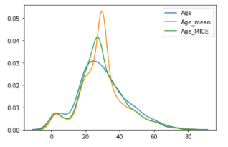
MICE Method
MICE stands for Multivariate Imputation by Chained Equation.
This is a rarely used and most efficient method for determining the missing values, as in this we treat each variable with missing values as the dependent variable in a regression, with some or all of the remaining variables as its predictors.
The MICE procedure cycles through these models, fitting each in turn, then uses a procedure called “predictive mean matching” (PMM) to generate random draws from the predictive distributions determined by the fitted models.
These random draws become the imputed values for one imputed data set.
The KDE Plot for Original data, Mean & MICE is as follows

Slide 5
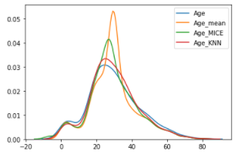
KNN Method
KNN stands for K-Nearest Neighbors, a simple algorithm that makes predictions based on a defined number of nearest neighbors. It calculates distances from an instance you want to classify to every other instance in the training set.
The KDE Plot for Original data, Mean, MICE & KNN is as follows

Slide 6
Thanks for Reading.
References
https://towardsdatascience.com/stop-using-mean-to-fill-missing-data-678c0d396e22
https://towardsdatascience.com/missing-value-imputation-with-python-and-k-nearest-neighbors-308e7abd273d

